Slide 1
LESSON 2
Graphics Hardware, Graphics APIs, Scene Representation & Transformations

Slide 2
Learning Objectives
Understand GPU architecture
Differentiate CPU and GPU processing
Explain the role of Graphics APIs
Understand scene representation in graphics
Explain coordinate systems and transformation pipeline

Slide 3
CPU vs GPU
CPU: Few powerful cores optimized for sequential tasks
GPU: Thousands of smaller cores optimized for parallel processing
GPUs perform large numbers of mathematical operations simultaneously
Essential for real‑time graphics rendering

Slide 4
Simplified GPU Architecture
Vertex Data
Shader Cores
Rasterizer
Fragment Shader
Framebuffer
GPU pipeline processes large amounts of geometry and pixel data in parallel.

Slide 5
Key GPU Components
Shader Cores: Execute vertex and fragment programs
VRAM: Stores textures, framebuffers, and vertex buffers
Rasterizer: Converts geometry into fragments
Output Merger: Depth testing and final pixel writing

Slide 6
Graphics APIs
Graphics API = interface between software and GPU
Used to send geometry and commands to the graphics hardware
Handles shader programs, buffers, and textures
Allows hardware abstraction across devices

Slide 7
Common Graphics APIs
OpenGL – widely used cross‑platform API
DirectX – Microsoft graphics API for Windows
Vulkan – modern low‑overhead graphics API

Slide 8
Scene Representation
A scene describes everything to be rendered
Includes geometry, lights, cameras, and materials
Organized using data structures such as scene graphs

Slide 9
Scene Graph Concept
Scene graph is a hierarchical structure
Objects are organized as parent and child nodes
Transformations applied to a parent affect its children

Slide 10
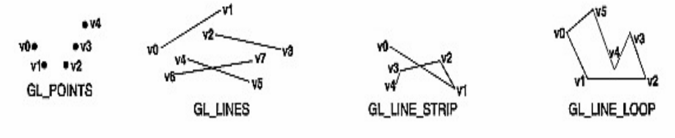
Coordinate Systems in Graphics
Object (Local) Space – coordinates relative to object
World Space – position in the full scene
View Space – relative to camera
Screen Space – final displayed coordinates

Slide 11
Graphics Transformation Pipeline
Object Space
World Space
View Space
Projection
Screen
Each stage transforms coordinates using matrix operations.

Slide 12
Example Transformation
Local object coordinate: (0,0,0)
Translate object by (5,0,0)
New world coordinate becomes (5,0,0)
Model matrix performs the transformation

Slide 13
Lab Exercise
Draw three cubes in a scene
Apply different translations to each cube
Rotate one cube around its own center
Observe difference between object and world space

Slide 14
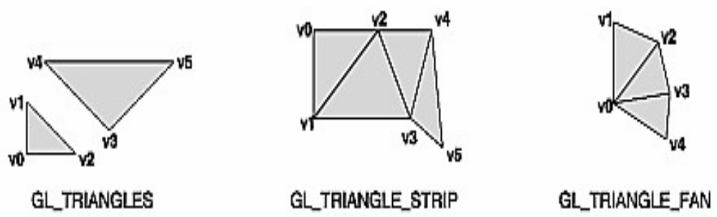
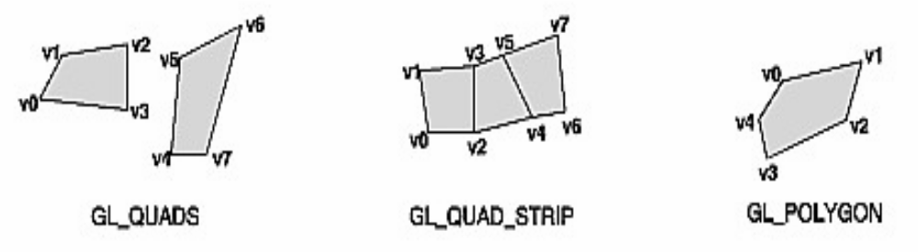

Slide 15
Key Takeaways
GPUs provide massive parallel computation for graphics
Graphics APIs connect software to GPU hardware
Scenes organize objects, lights, and cameras
Transformation pipeline converts object coordinates to screen pixels

Slide 16
REVISION QUESTIONS
Q1. What is the main difference between CPU and GPU?
Answer:
A CPU is optimized for sequential processing with few powerful cores, while a GPU is optimized for parallel processing with thousands of smaller cores designed for mathematical computations required in graphics rendering.
________________________________________
Q2. Define a Graphics API.
Answer:
A Graphics API is a software interface that allows applications to communicate with the GPU to render graphics, manage memory, and execute shader programs.
________________________________________
Q3. Give two examples of graphics APIs.
Answer:
• OpenGL
• DirectX
(Other valid answer: Vulkan)
________________________________________
Q4. What is object space?
Answer:
Object space (local space) refers to coordinates defined relative to the object's own origin before any transformation is applied.
________________________________________

Slide 17
Q5. What is world space?
Answer:
World space refers to coordinates of objects after transformations have positioned them within the overall scene.
________________________________________
Q6. Why are GPUs better suited for graphics rendering?
Answer:
Because rendering involves performing the same mathematical operations on many vertices and pixels simultaneously, which benefits from the GPU’s highly parallel architecture.
________________________________________
Q7. Explain the role of a scene graph.
Answer:
A scene graph organizes objects hierarchically, allowing parent-child relationships so transformations applied to a parent automatically affect its children.
________________________________________

Slide 18
Q8. If an object is at local coordinate (1,0,0) and translated by (5,0,0), what is its world coordinate?
Answer:
(6,0,0)
________________________________________
Q9. Why do we need multiple coordinate systems?
Answer:
Multiple coordinate systems allow structured transformation of objects from modeling space to display space, enabling camera movement and scene organization.
________________________________________
Q10. What happens if we move the camera instead of the object?

